Slide 1
Spring/Summer
Edgar Mandujano
PCA/CCA
707-836-6025
Vineyard
Disease control
Weed control
Nutrition

Slide 2
Disease Control
Sulfur |  |  |  | Frac 11 |  | Biologicals
Micronized Sulfur-Cosavet DF |  |  |  | Narvos |  | Milagrum Plus
Dusting Sulfur-MarVista Dusting Sulfur |  |  |  | Flint |  | Stargus
 |  |  |  | Abound |  | Regalia
Oil |  |  |  |  |  | Serenade
Green Furrow Vista Clear Oil |  |  |  | Frac 9 |  | Serifel
JMS Stylet Oil |  |  |  | Scala
 |  |  |  | Vangard
Copper
Badge |  |  |  | Combined MOA
Nordox |  |  |  | Luna Experience 3+7
 |  |  |  | Pristine 7+11
Frac 3 |  | Unique MOA |  | Quadris Top 3+11
Rhyme |  | Gatten |  | Inspire Super 3+9
Rally |  | Quintec |  | Switch 9+12
Mettle |  | Torino
Cevya |  | Vivando |  | Short REI materials
 |  |  |  | Elevate
Other |  |  |  | Ph-D
Kaligreen
Surfactants
Vintre
Surf-90
Vista Sil 100
Oroboost

Slide 3
In Season Weed Control
Herbicides
Total TNV (Glufosinate)
Venue
Shark
Fusilade
Poast
Surfactants
Surf Ammo AMS
MSO
Liquid AMS
Contain

Slide 4
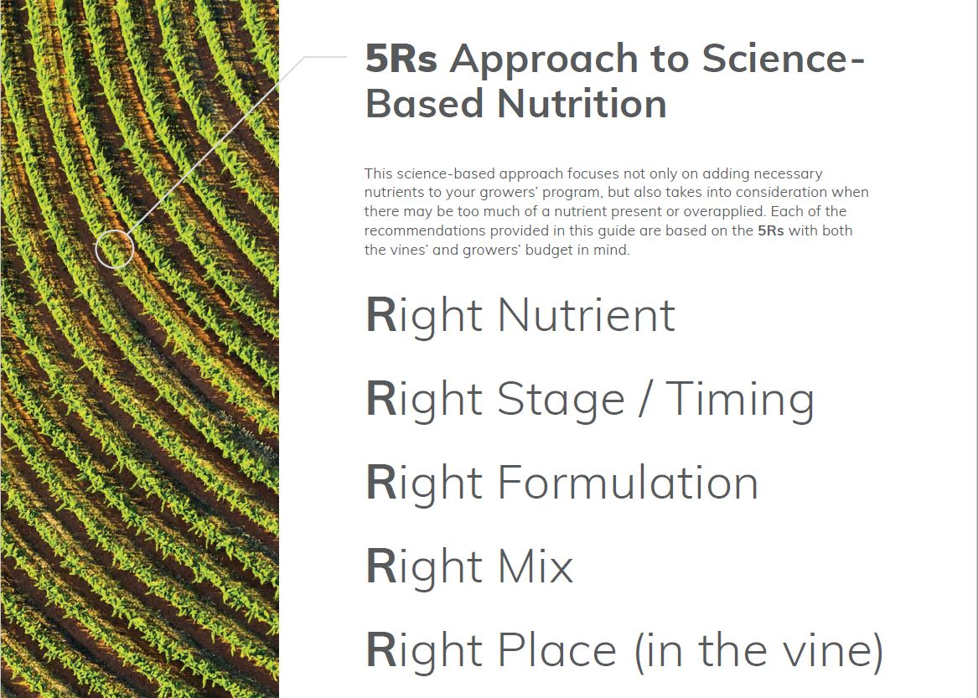
Vine Nutrition

Slide 5
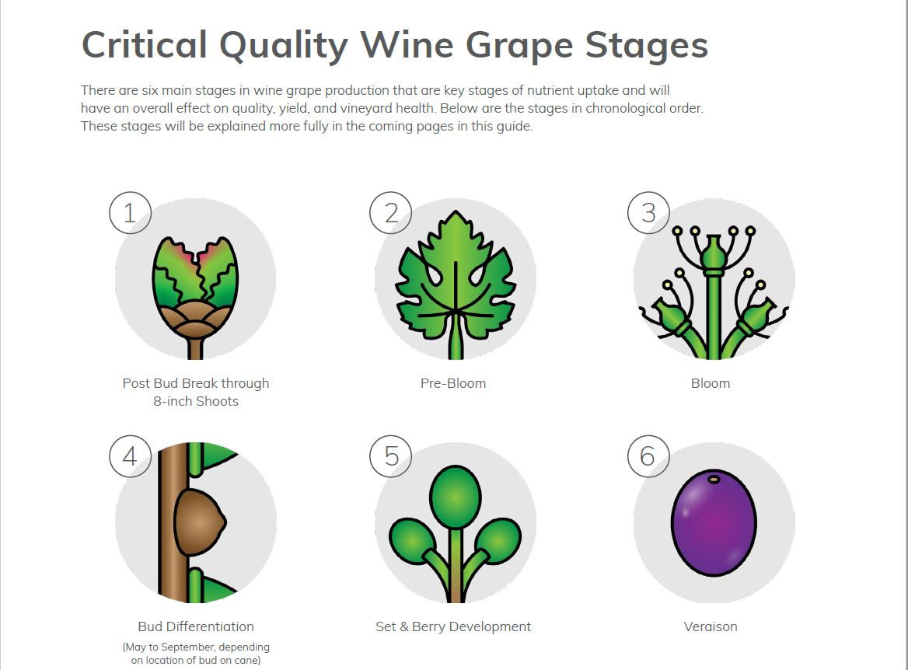

Slide 6
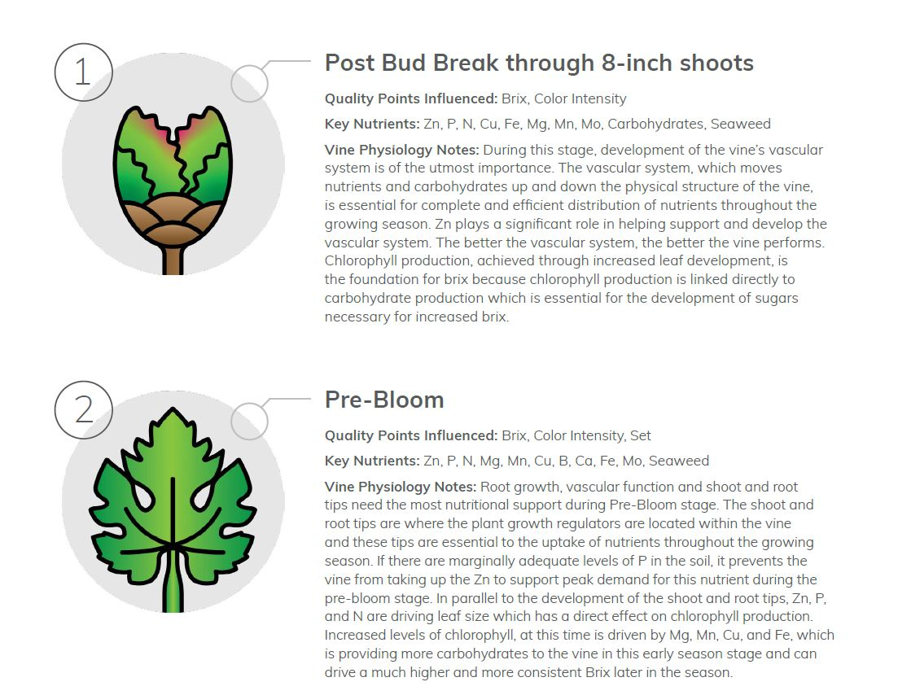

Slide 7
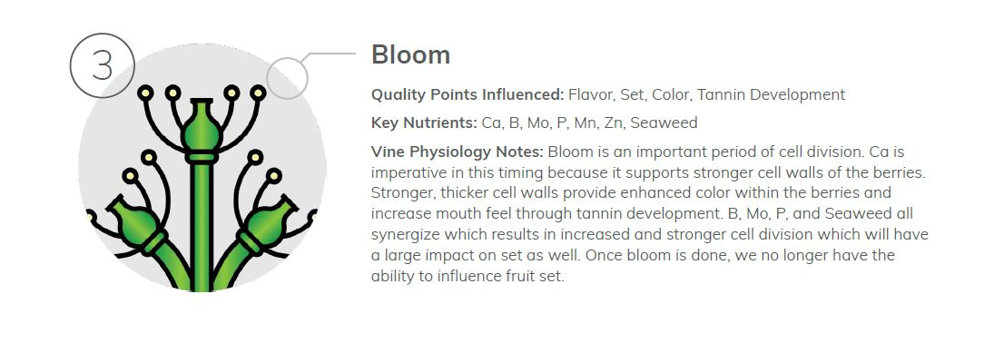

Slide 8
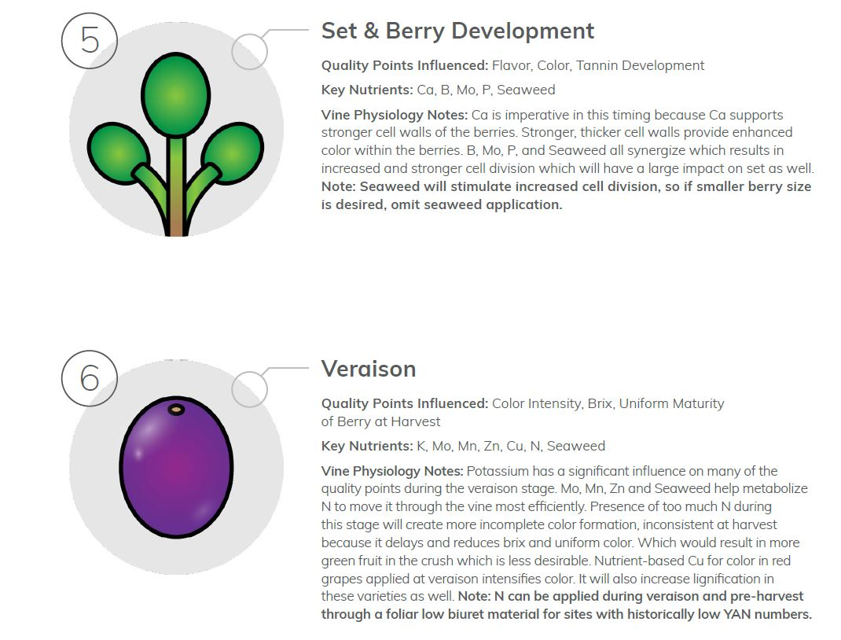

Slide 9
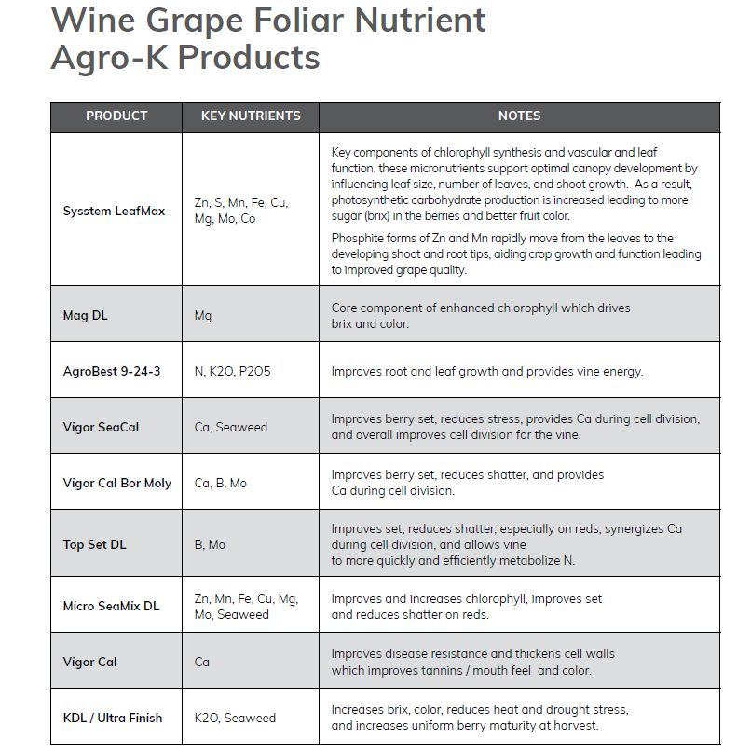
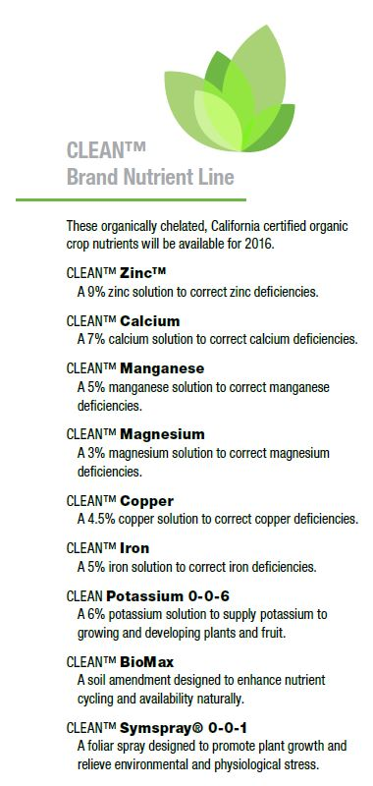
Other formulations
Slo-N 30-0-0
Slo-N+K 11-0-16

Slide 10
Timing is key!

Slide 11
Drip Nutrition
KTS 0-0-25
0-0-30 Pot Carb
CaTs
Mag Thio
Can-17
Cn-9
True 5-1-2
True 3-1-5
N-Texx
Vermi Extract
ACHA Humic Acid
Custom N-P-K blends

Slide 12
Thank you!
Edgar Mandujano PCA/CCA
Grow West North Coast
707-836-6025
*This presentation has been designed using resources from PoweredTemplate.com

